Slide 1

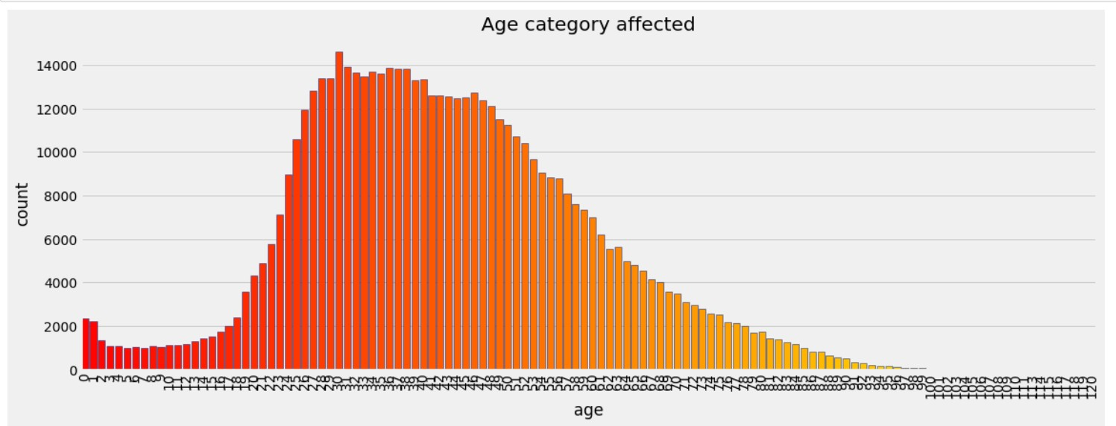
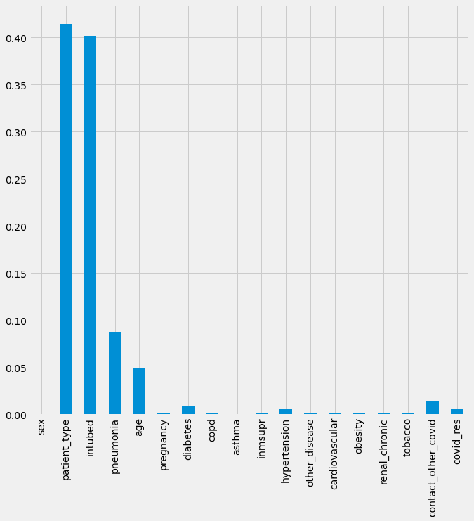
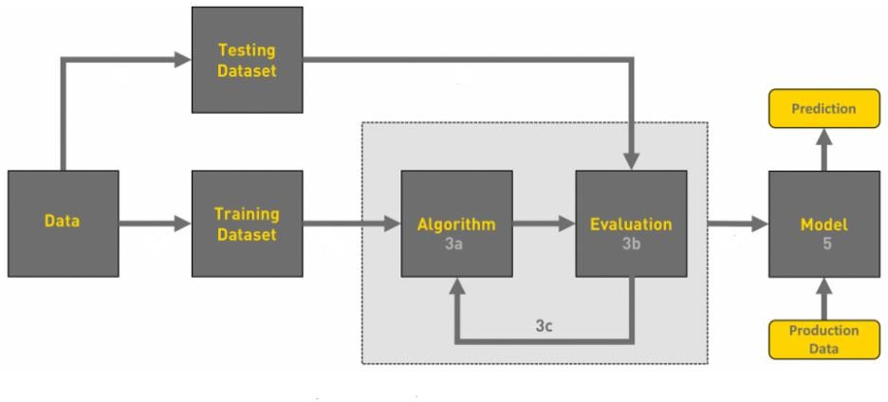
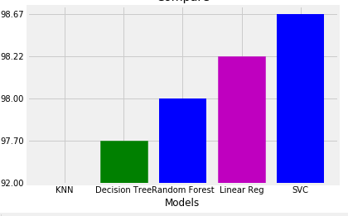
Covid Severity Prediction using Machine Learning
Raghavendra A Samarth D Valmiki R Hemanth Kumar
r18cs317@cit.reva.edu.in r18cs364@cit.reva.edu.in r18cs311@cit.reva.edu.in
Kuruva Hithendra SaiKumar
r18cs520@cit.reva.edu.in Guide Name: Prof. Harshini R
Department of Computer Science and Engineering, REVA University
d & Amin, M.(2015). Design and Construction of a Multipurpose Robot. International Journal of Automation, Control and
Intelligent Systems. 1. 34-46.
Conclusion
Abstract
objectives
Results
The proposed model is data-dependent and is subject too
modification in the covid-19 virus. The model will be needing
new data to understand patients accurately. The data set needs
to be large with more features to play with so that we are sure
it performs accurately. This model can be deployed with real-time data and used by doctors to classify the patients at the
beginning. The model can be modified for other risk predictions
of another disease.
Coronavirus sickness was identified as an infectious pandemic, affecting millions of people around the world. Healthcare institutions, particularly in underdeveloped nations, are at risk of exceeding their limit and capacity due to a lack of vaccines and rapid virus transmission from person to person. As a result, it is critical to appropriately manage resources in these countries in order to limit the high death rate and the resulting damage. It has resulted in a large number of deaths, resulting in a global state of emergency. In order to deal with the limitation of resources, we took data from COVID-19 positive patients and constructed and applied a machine learning classification model to forecast the severity of the illness.
Is to get high accuracy.
Is to improve the performance and reduce the computational speed.
Is to improve the visualization.
Is to avoid information loss during extraction.
.
.
Proposed Solution
Datasets plays a key role in the process of choosing the right algorithm for the right problem. Random Forest Algorithm is used to classify the patient’s records. There are many Machine Learning techniques that can be applied for this problem statement. Machine learning techniques include supervised learning, regression, etc. The appropriate technique that can be used for this problem statement is supervised machine learning technique. To categorize the problem by input and/or output and to understand the data. Some algorithms can work with smaller sample sets while others require tons and tons of samples. After exploring the dataset, the selection of features plays an important role. A computational model will be developed by applying the algorithms that will efficiently detect patient healthcare report. Several supervised learning algorithms are proposed among which an efficient algorithm is selected which helps us to achieve better accuracy effectively.
Future scope
Fig 2.Severity of patients
This model can be deployed with the real time data and used by doctor to classify the patients at the beginning. The model can be modified for other risk prediction of other disease.
Introduction
The novel Coronavirus disease was first reported in China, in December 2019. It quickly spread over the globe. The causal virus’s cumulative incidence quickly raised and affected 196 nations and territories, with the United States, Spain, Italy, United Kingdom, and France among the most affected followed by India. The World Health Organization declared the outbreak of the coronavirus a pandemic as the virus continued to spread. New solutions are needed to generate, manage, and analyze large amounts of data on the incidence of conditions, patient data, and community activity, as well as to integrate clinical trial data, medications, genetics, and public health data. Researchers can predict where and when the disease will spread by combining this data with machine learning (ML) and artificial intelligence (AI) and warning those areas to be prepared.
The main motivation for the COVID-19 Patient Severity
prediction based on the patient’s record is the global havoc it
has created, and the suffering people are undergoing through
this. In this paper, we are trying to build a Machine Learning
model to predict the severity of a patient based on their previous medical records and travel history. As it is known that a patient’s previous health state plays a gargantuan role in
deciding whether a person can survive the pandemic, we have
decided to use Machine learning to check and tell who suffers
the most specific and allied factors for the severity of infection on the patient.
[5] Zaman, M. & Ahmed,
References
Methodology
[1] Sina F. Ardabili and Amir Mosavi, ‘’ COVID-19 Outbreak Prediction with Machine Learning “,ResearchGate publications,May 25 .2020.
[2] Furqan Rustam, Aijaz Ahmad Reshi, (Member, IEEE), Arif Mehmood 3, Saleem Ullah, Byung-Won, Waqar Psalm,” COVID19 Future Forecasting Using Supervised Machine Learning Models “, IEEE Access, Vol. 8, May 5 .2020.
[3] Zirun Zhao, Anne Chen, Wei Hou, James M. Graham, Haifang Li, Paul S. Richman, Henry C. Thode, Adam J. Singer, Tim Q. Duong “Prediction model and risk scores of ICU admission and mortality in COVID-19“, PLOSON, https://journals.plos.org/plosone/article/file?type=printable&id=10. 1371/journal.pone.0236618 ,18 July 30, 2020.
[4] Roseline Oluwaseun OGUNDOKUN, Joseph Bamidele AWOTUNDE, “Machine Learning Prediction for COVID 19 Pandemic India”, https://www.medrxiv.org/content/10.1101/2020.05.20.20107847v1 ,May 26, 2020.
[5] Prathamesh Parchure, Himanshu Joshi, Kavita Dharmarajan, Robert Freeman, David L Reich, Madhu Mazumdar, rem Timsina, Arash Kia “Development and validation of a machine learning- based prediction model for near-term in-hospital mortality among patients with COVID-19 “, 18 August. 2020.
[6] Andre Patricio, Rafael S. Costa and Rui Henriques “COVID-19 in Portugal: predictability of hospitalization, ICU and respiratory assistance needs” , pp.1-8, https://www.researchgate.net/publication/345968499_COVID19_in_Portugal_predictability_of_hospitalization_ICU_and_respir atory-assistance_needs .
Fig 3.Feature importance from classifier
Problem statement
To implement a method to predict infectious severity of the patient prediction based on the patient health records. Since there is a lot of ambiguity in deciding which patient requires intense care and who is more susceptible to death.
Fig 4. Results of test sets

